Slide 1
Automating Access Management with Entra
Extending Access Management to all the things
Notes:
Other resources: https://identity-man.eu/2023/02/15/using-the-hidden-gems-in-azure-ad-access-packages-all-you-need-to-know-part-1/
https://learn.microsoft.com/en-us/entra/id-governance/entitlement-management-logic-apps-integration https://medium.com/@alex.jaya/id-governance-workflow-with-custom-extensions-logic-apps-using-logic-apps-custom-api-connector-c3e7e5d04281

Slide 2
Attention
MMS sessions are 60-75 minutes followed by LONG Q&A
Please hold detailed questions until that Q&A starts
Feel free to ask clarification questions
Remind the speakers to use Zoom It when you can’t see

Slide 3




Adam Gross
Nathan McNulty
Computing Solutions Manager Chevron Phillips Chemical Co
Sr. Security Solutions Architect Patriot Consulting
adam@asquaredozen.com @AdamGrossTX
nathan@nathanmcnutly.com @nathanmcnulty

Slide 4
Admin and User Experiences
Let’s see what this looks like
Notes:
3 workflows
Creating a package, new policy, direct assignment
Request with approval workflow
Request with Verified ID

Slide 5
The Entitlement Management Journey
What is entitlement management?
How does entitlement management help me?
Where can I use this, and what can I use it for?
Notes:
Most of us started with ADUC, manually adding users to groups, got smart, and moved to PowerShell. Some are lucky to have an IAM solution to automate group membership, but these typically end up overly permissive (everyone gets all groups even if they don’t need it) and still aren’t ideal for special requests, exceptions, time-bound needs, etc.
For these scenarios, we’ve turned to service desk tickets and PAM solutions, sometimes automated by forms or actions from service desk software. But these are usually custom built workflows that lack cleanup and oversight on usage or aren’t designed for end user consumption. And sometimes that’s OK, but sometimes there might be a better option ☺
If we’re at a big enough organization, we’re often multiple layers away from all of this stuff, and we’re competing for priority to have our workflow built, our group membership populated, our access granted. There’s a lot of moving parts here to set up proper delegation, and sometimes it’s not even feasible when dealing with some 3rd party systems.

Slide 6
What is Entitlement Management?
Entitlement can be a good thing?
Notes:
TODO: Make more concise, add questions about workflows orgs currently use to address these scenarios, share what we’ve seen
“Entitlement management is an identity governance feature that enables organizations to manage identity and access lifecycle at scale, by automating access request workflows, access assignments, reviews, and expiration.
People in organizations need access to various groups, applications, and SharePoint Online sites to perform their job. Managing this access is challenging, as requirements change. New applications are added or users need more access rights. This scenario gets more complicated when you collaborate with outside organizations. You might not know who in the other organization needs access to your organization's resources, and they won't know what applications, groups, or sites your organization is using.
Entitlement management can help you more efficiently manage access to groups, applications, and SharePoint Online sites for internal users, and also for users outside your organization who need access to those resources.”
Stolen from: What is entitlement management? - Microsoft Entra ID Governance | Microsoft Learn
Entitlement management provides us with a way to organize resources (group membership, application assignment, SharePoint access, and Entra roles) into Catalogs where those with appropriate permissions can create Access Packages, a container for any of these resources, that can be granted or assigned to users with a ton of flexible controls. Many times our service desk flows require checking a user’s department, job code, or licensure to grant access, and we can automatically determine how a user interacts with an Access Package based on policy that already takes these into account.
By now, you are probably thinking about the various ways you manually create and maintain group membership for testing/pilots, rolling out Enterprise SaaS apps, and maybe external guest workflows. We can define policy that automatically assigns Access Packages based on user attributes, allows users to request access that is either automatically approved (based on policy) or goes through an approval workflow (that is built into the solution), and optionally review that access to make sure they are using it and even automate removal if they are not.

Slide 7
Resources, Access, Governance, Oh My
Resources – securable objects we can define access to
Access – a defined set of permissions for a resource
Governance – policy defining assignment/review/removal
Entitlement – permission to access resources given by policy
Notes:
Most are familiar with IAM (Identity and Access Management), but many have never heard of IGA (Identity Governance and Administration)
Governable resources in Entra – groups, applications, SharePoint sites, and roles
Access – groups can be owner or member, applications could be any supported app role, SharePoint sites could be Owner, Member, or Visitor, and roles can be any Entra role
Governance – guardrails and processes for when access can be granted or taken away
Entitlement – the result of policy when a user is “entitled” to have access to a resource

Slide 8
Walkthrough of Access Packages
There’s more to it than you’d think
Notes:
Cover all components of Access Packages including additional policies, incompatible groups/access packages, touch on access reviews
Bonus: Build LAPS Logic App and update access package

Slide 9
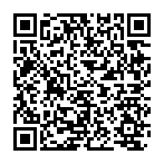
Managing at scale
Delegation model allows non-admins to manage access
Catalogs provide granular control over resource delegation
Graph API provides access to IAM and automation solutions
https://learn.microsoft.com/en-us/entra/id-governance/entitlement-management-delegate
Notes:
Talk about limitations and risks when all delegation is done from a single catalog
Logic Apps can be associated with Catalogs as “extensions” which can then be used to perform custom tasks when an event happens with an access package

Slide 10
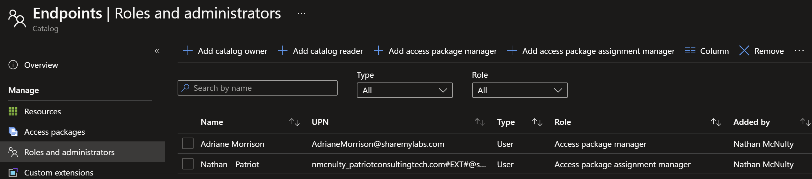
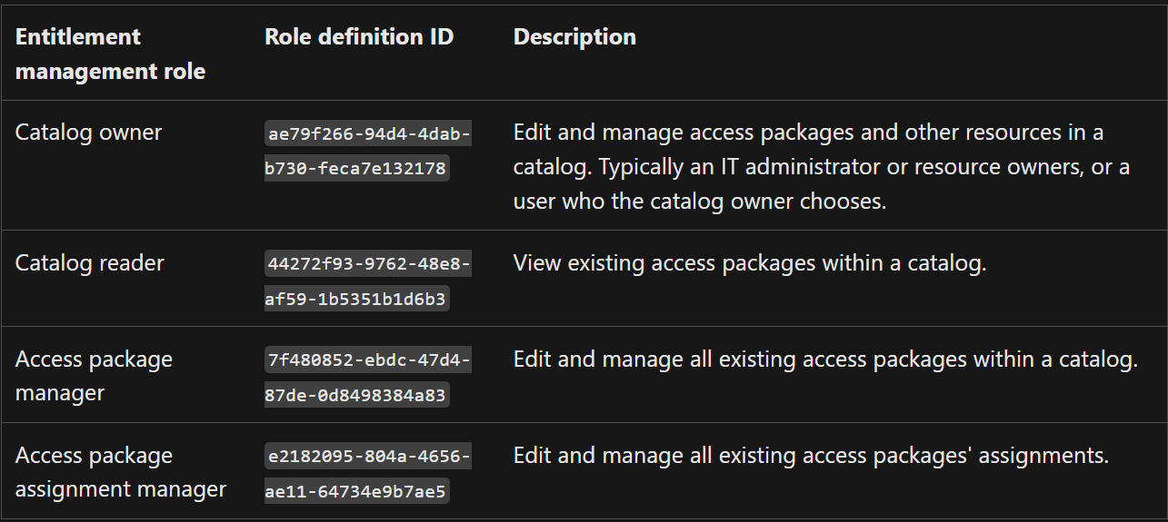
Roles for delegation
Notes:
Not shown here is the catalog creator role

Slide 11
Walkthrough of Delegation
You gave them permission to do what?
Notes:
Build LAPS Logic App

Slide 12
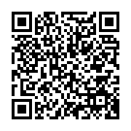
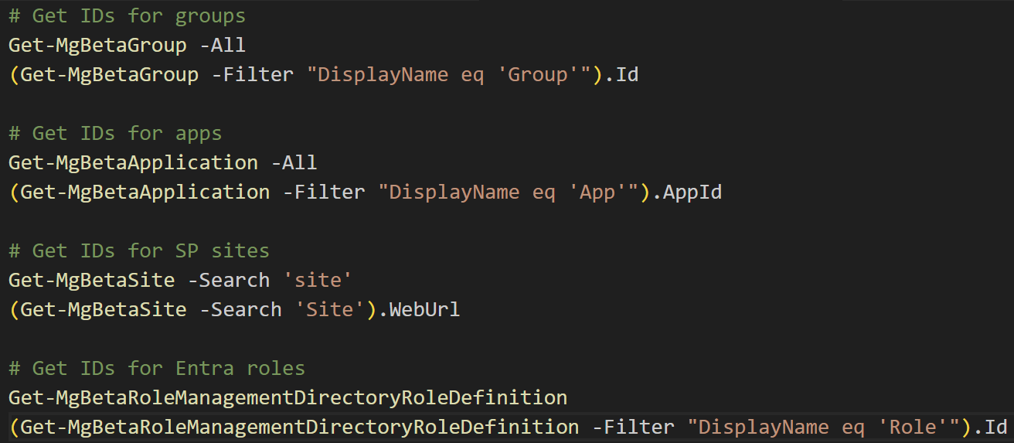
API Tutorial
https://learn.microsoft.com/en-us/graph/tutorial-access-package-api?tabs=powershell
Notes:
The tutorial has excellent documentation for adding resources to catalogs, for creating access packages with resources added, etc., but they don’t have good examples of how to get the information needed to reference resources.
Groups, apps, and roles are simple – the object ID
SP Sites are actually the web URL, discovery can be lame
# Get IDs for groups
Get-MgBetaGroup -All
(Get-MgBetaGroup -Filter "DisplayName eq 'Group'").Id
# Get IDs for apps
Get-MgBetaApplication -All
(Get-MgBetaApplication -Filter "DisplayName eq 'App'").AppId
# Get IDs for SP sites
Get-MgBetaSite -Search 'site'
(Get-MgBetaSite -Search 'Site').WebUrl
# Get IDs for Entra roles
Get-MgBetaRoleManagementDirectoryRoleDefinition
(Get-MgBetaRoleManagementDirectoryRoleDefinition -Filter "DisplayName eq 'Role'").Id

Slide 13
Walkthrough of Graph API capabilities
For those times when you don’t want to use a browser
Notes:
Will show examples using both Graph PowerShell and native Graph API calls
Hoping to also have a quick view of a Logic App or two

Slide 14
How does Entitlement Management help me?
This had better be life changing
Notes:
Key takeaway is that it should reduce administrative overhead while also providing a better user experience – a rare win when it comes to security related things, right? ☺
Be sure to emphasize that all of this can apply to external identities such as other orgs or guests as well

Slide 15
What problems are we solving?
Addresses overly permissive access by default
Automates slow, manual, and poorly defined processes
Automates review and cleanup of access
Notes:
Talk about typical workflow to assign access to resources:
- Usually overly permissive (all X department gets access to X resource)
- Manual processes (Help desk ticket -> Add user to group/app/site/role)
- Rarely reviewed or cleaned up (roles change -> keep previous access)

Slide 16
What other problems are we solving?
Users don’t know what is available leading to shadow IT
Admins are over privileged to grant access to all resources
Reduces risk for admins making ad-hoc changes
Notes:
Focus on better user experiences and simplified workflows
- Easier for user to discover and request access
- Easier for admins to define and grant access based on roles, departments, or other use cases
- Codifies access in a way that makes the process easier and less susceptible to misconfiguration

Slide 17
Use Cases and Examples
More scenarios than you can shake a stick at

Slide 18
Extending Access Management to all the things
Microsoft cloud scenarios
Endpoint management scenarios
On-premises scenarios
Notes:
Bunch of examples:
https://learn.microsoft.com/en-us/entra/id-governance/entitlement-management-scenarios
Microsoft Cloud examples (always highlight restricted AUs, token lifetime)
Conditional Access: Geofencing, device code flow, account recovery (restrict TAP), guest scenarios (block all guest access by default), APP (block by default), device join/register (auth strength trick)
Enterprise apps: Access to paid apps, role assignment in SSO apps (Splunk, AWS, etc.) / SCIM provisioning, EXO/AzureAD/Graph modules (block by default, register app)
Entra authentication methods: Limit SMS, passkey early adopter, SSPR
SharePoint: Guest scenarios, software library
Azure: Azure Storage?
Role assignment: Exchange Admin or eDiscovery Admin with Face Check?
Intune: Device join/Device enrollment restrictions, Paid apps (make available in CP), Admin rights script?, OS upgrades, LOB software upgrades (like Autodesk), granular APP/Compliance/Config profiles
Purview: Access MIP encrypted content
On-Prem examples (always highlight Kerberos lifetime)
File share access
IIS / app server access
Server admin group
Printing?

Slide 19
Microsoft Cloud Use Cases
If it’s in Microsoft’s cloud, we can use it
Notes:
Conditional Access exclusions (be sure to show groups in restricted admin units)
- Geofencing
- Device code flow
- Logic app using MI to perform actions in other places (maybe even show Exchange linked SP)

Slide 20
Endpoint Management Use Cases
Let’s use this for device management
Notes:
User requests access to paid software, that goes through a couple approval steps, and then becomes available in Company Portal
User requests participating in a pilot (like WHfB, FUs, new apps, etc.) which then puts them into a group targeted by policy
Maybe some tie ins with AVD/W365 or other licensing scenarios

Slide 21
On-premises Use Cases
People still have on-prem? 🙃

Slide 23
Notes:
Speakers, please stay on this page for the second half of your session.

